Slide 1


Slide 2


Slide 3


Slide 4


Slide 5


Slide 6
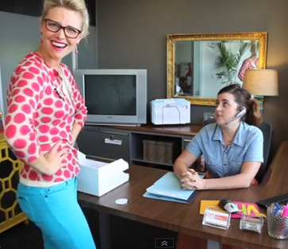

Slide 7
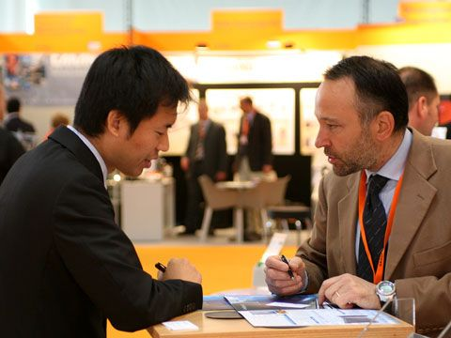

Slide 8
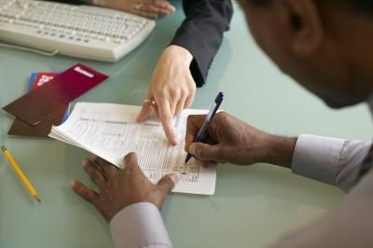

Slide 9
Sun | Mon | Tues | Wed | Thurs | Fri | Sat
6hrs |  | 3 hrs | 3 hrs | 3 hrs |  | 5 hrs
Less than 40 hours

Slide 10
Sun | Mon | Tues | Wed | Thurs | Fri | Sat
 | 8 hrs | 8 hrs | 8 hrs | 8 hrs | 8 hrs
40 hours

